Slide 1


Unit 1, Spectacular Saguaros
Driving Question:
How does the saguaro survive in the Sonoran Desert?
Photograph by Jay Pierstorff
Notes:
Introduce the driving questions for the unit.

Slide 2
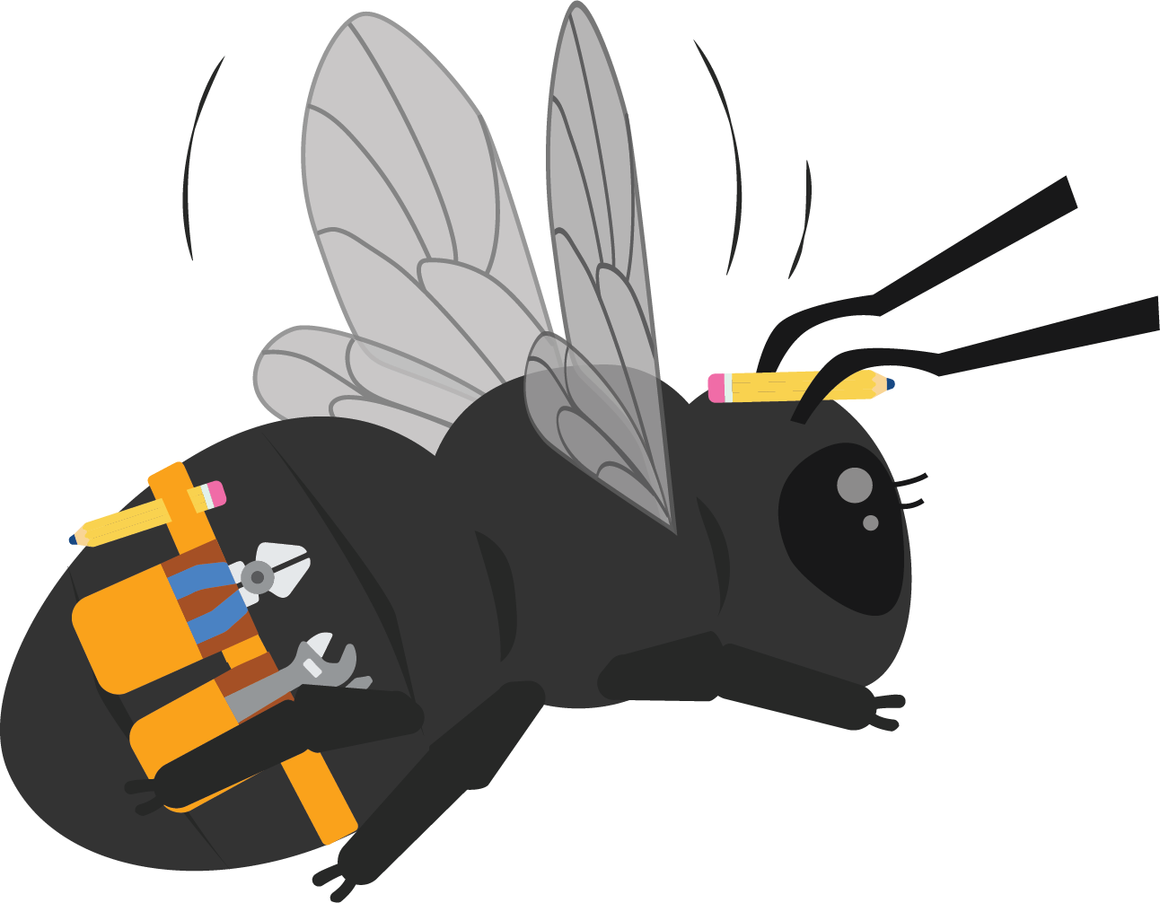
Hi 1st Graders!
Hi! I’m Beatrice the Bee! I’m a Carpenter Bee, so I won’t sting you! I love to solve problems and am here to help you build your desert knowledge.
This month I’m going to hang out with you and learn about Saguaro cacti!
I’ll give you some challenges along the way.
Are you ready? Let’s go!

Slide 3
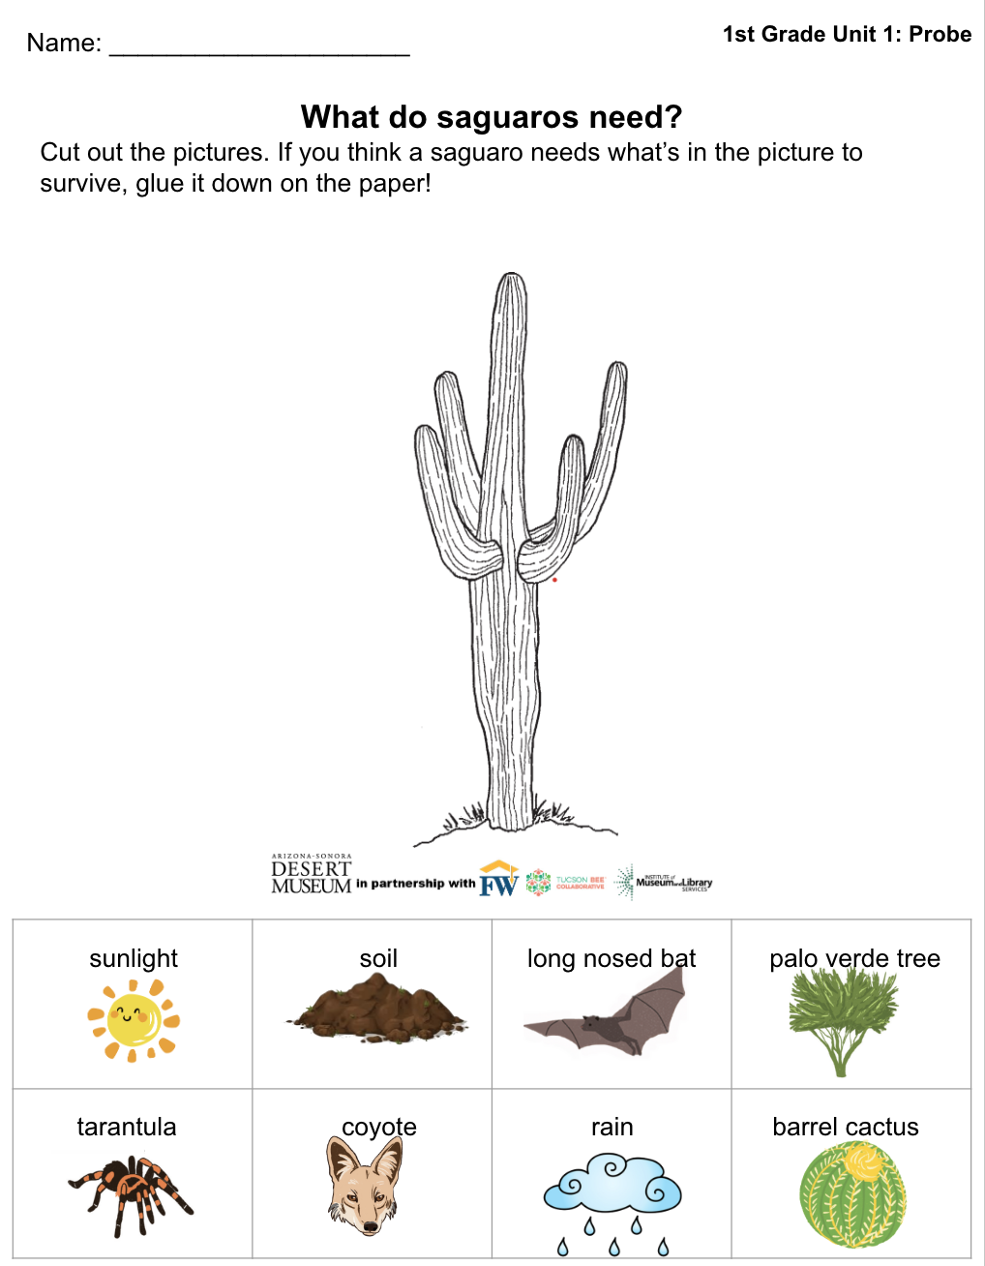
Probe
What do you think a saguaro cactus needs to grow?
Over the next few weeks we will learn all about saguaro cacti!
Today, you will get a picture of a saguaro and some smaller pictures of things it might need to grow and survive! Cut out the images. The ones you think help a saguaro, glue near the cactus! If you don’t think a saguaro needs one of the pictures, glue it on the back of your paper!
Notes:
Give students the probe worksheet. Have students cut and glue what they think a saguaro needs to live and grow in the desert on the paper. Use this to see what misconceptions students may have about saguaro needs. If you have time, have students discuss as a class what they chose as a need and why (or why not!)

Slide 4

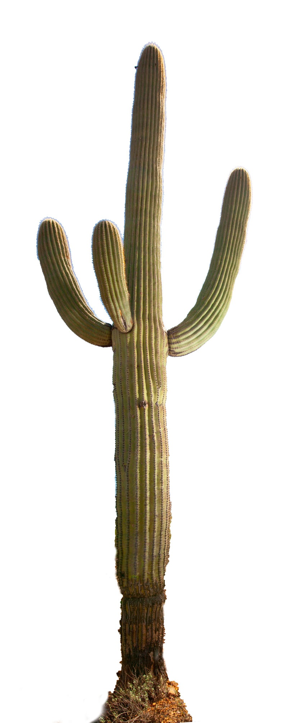
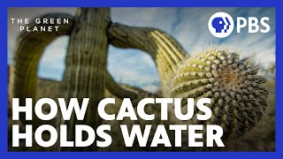
Time Lapse of a Saguaro
Phenomena
Let’s watch a video of a saguaro over time. We are watching it on mute for now!* Think: What do you notice? What do you wonder? Be ready to share your thoughts!
*Teachers, click the image below to play the video. Stop play and select mute at the start before playing so students can watch the video without sound.
Notes:
Show students the time lapse video of a saguaro. Have students discuss what they notice and wonder about the saguaro over time, and write their ideas down to create a “wonder wall” chart. Point student discussion towards how they visibly see the saguaro change, as well as what kinds of plants and weather they notice in the saguaro’s vicinity. KEEP THE VIDEO MUTED, as it explains what we want students to explore in the following lessons. Feel free to watch the video after the explore lessons with sound on!

Slide 5
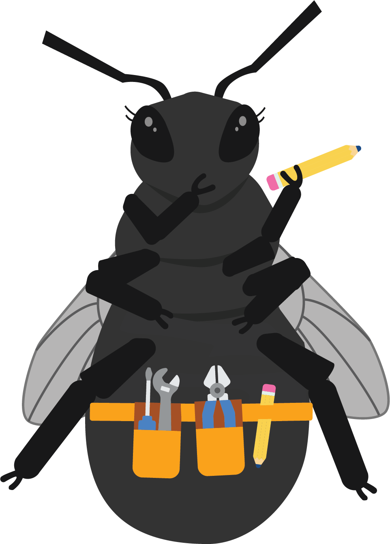
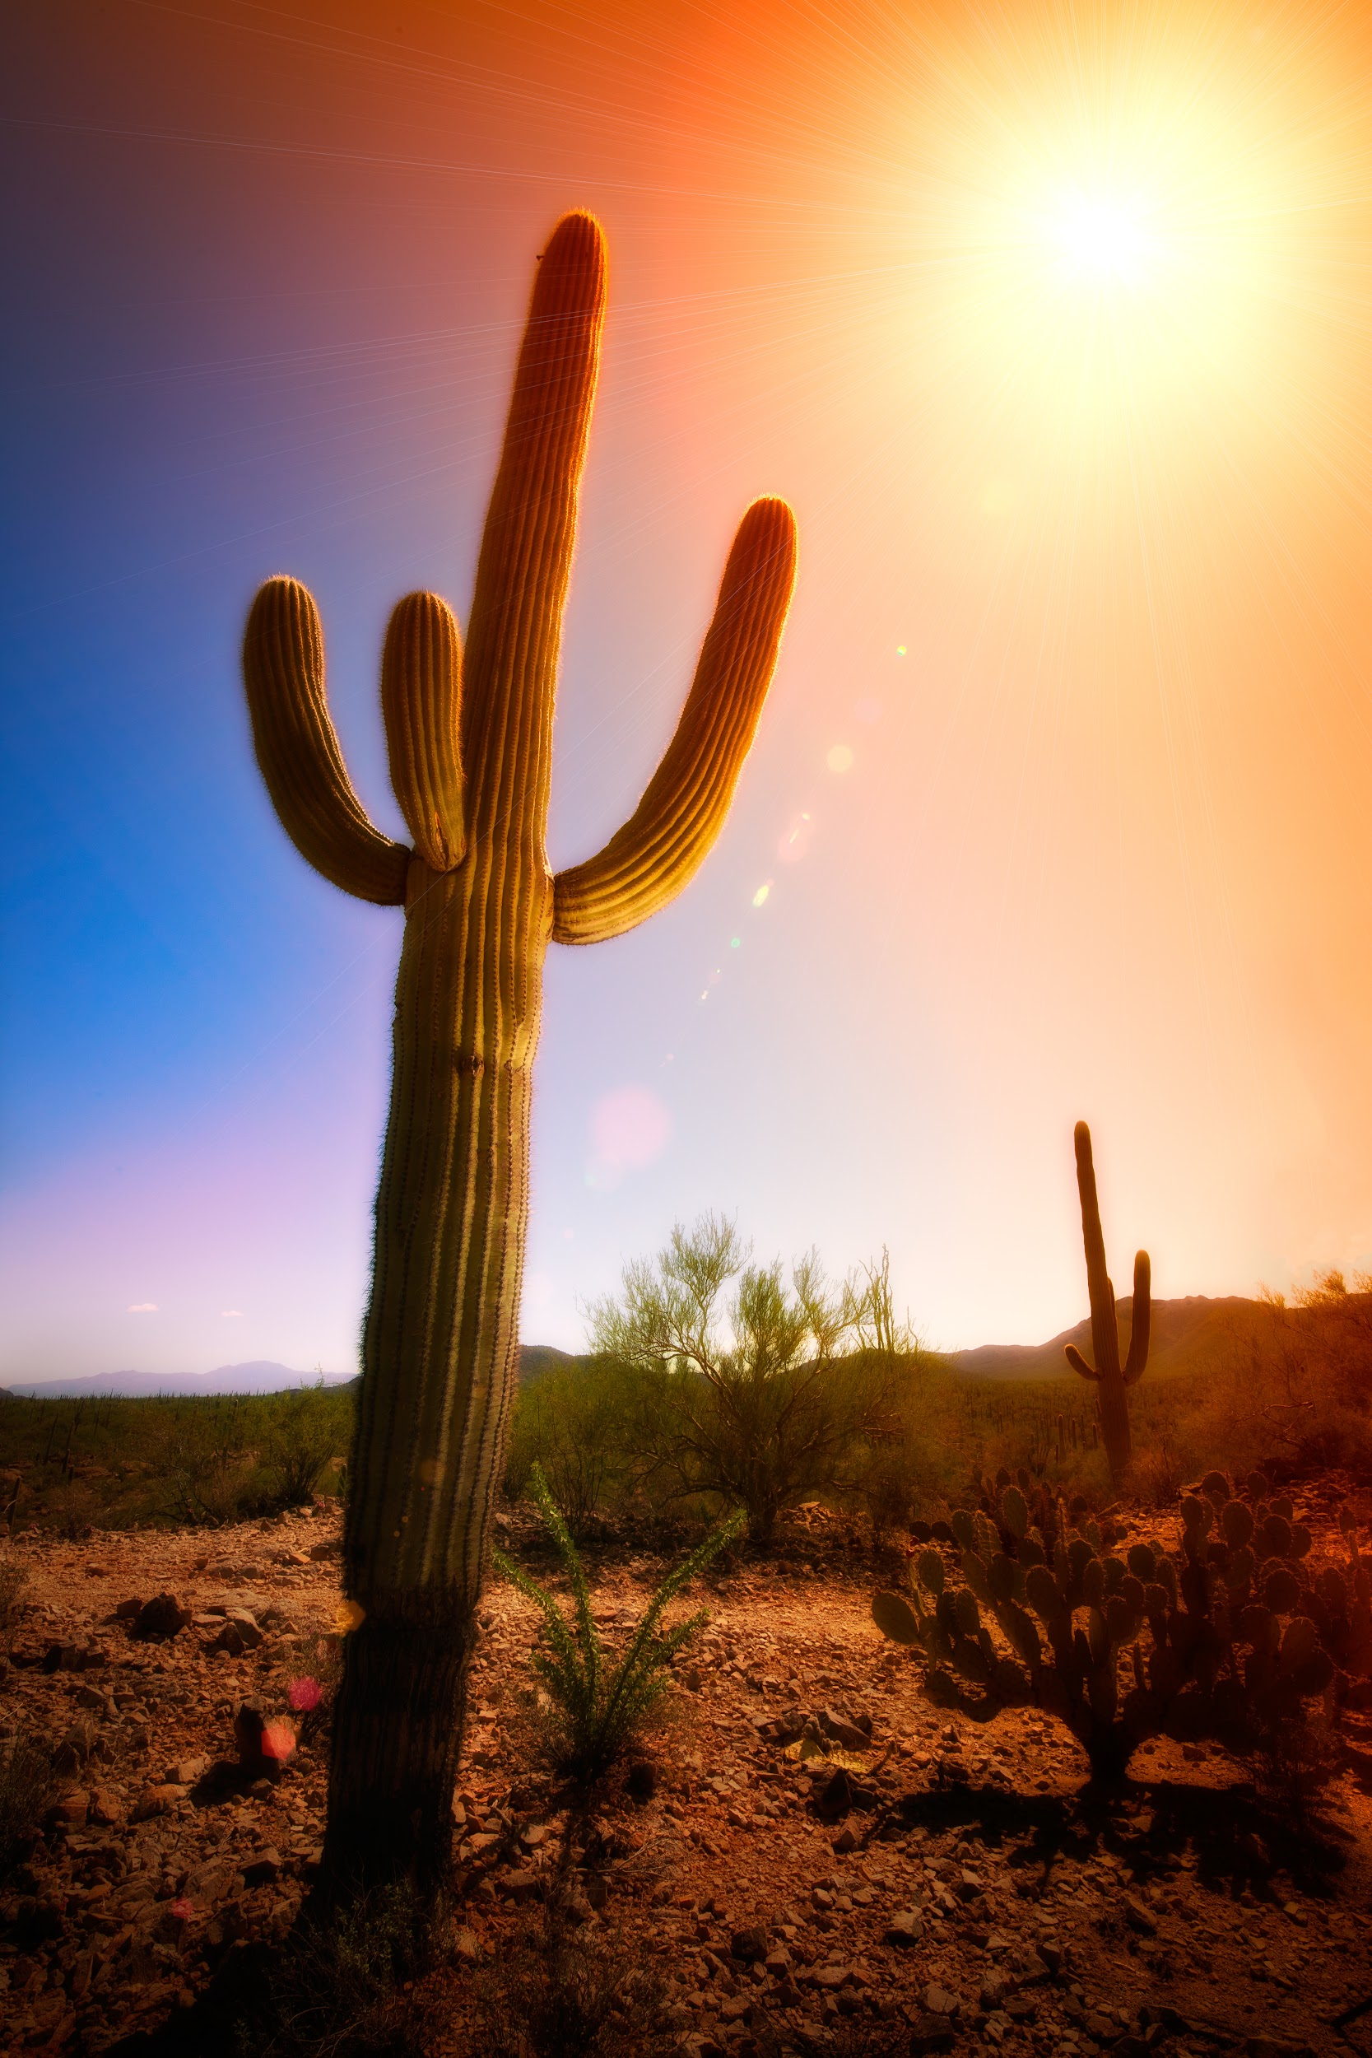
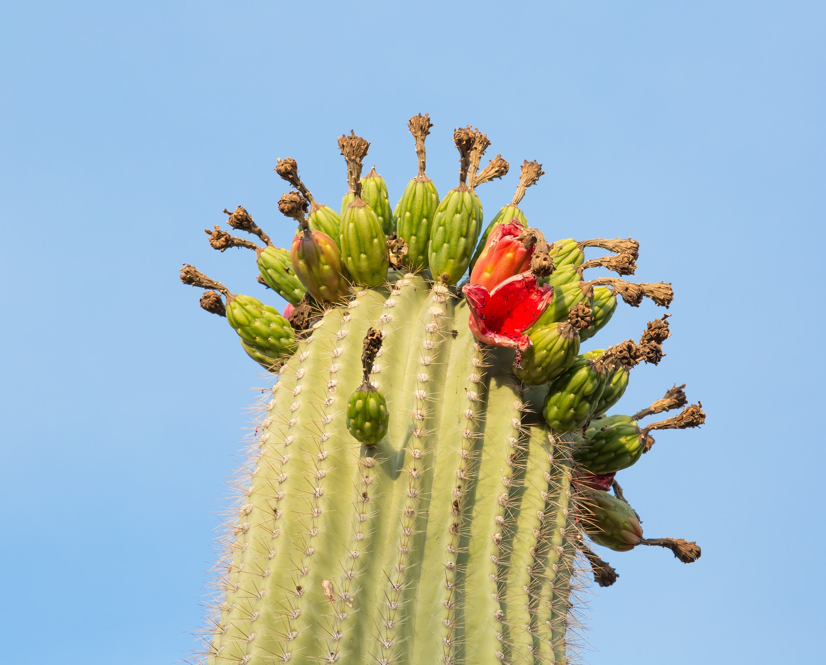
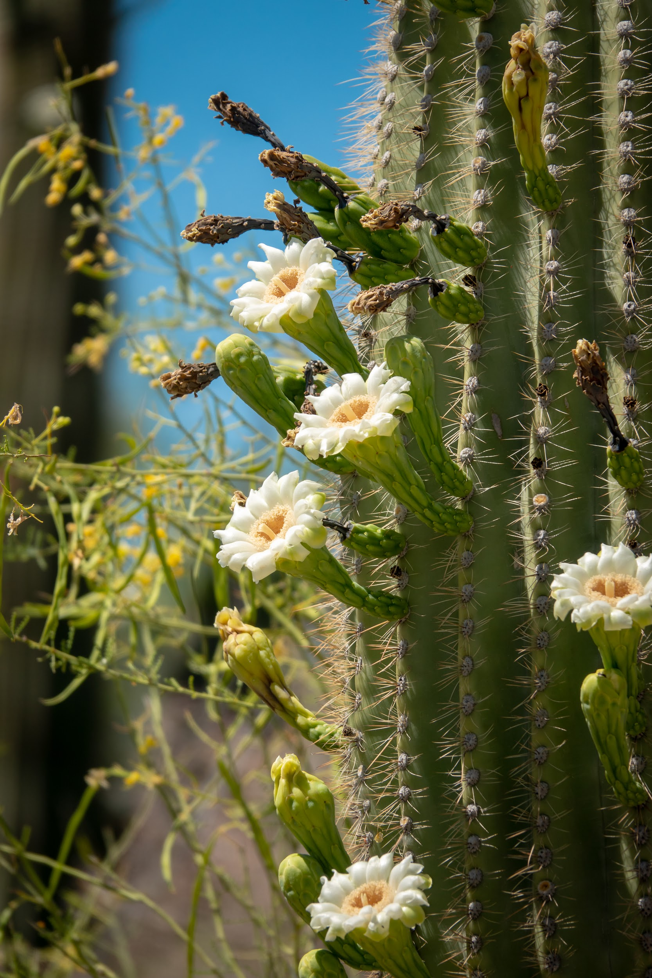
Engage
Now let’s look at some pictures of saguaros. What do you notice about them?
If you were going to draw a saguaro, what kinds of details would you need to draw?
Photographs by Jay Pierstorff
Notes:
Have students discuss what they notice about a saguaro. Is it smooth or bumpy? What is the skin like? What is the shape like? Etc.

Slide 6
Stay Hydrated, Saguaros!
Explore-Part 1
What do we know about weather in the desert? Does it rain a lot here?
We know that plants need water to survive. Today, let’s explore how a plant like a saguaro might hold onto water!
Notes:
As a class, wet two paper towels. Wrap one of the wet towels in wax paper and tape it shut. Leave them for a significant amount of time (overnight possibly).

Slide 7
Explore-Part 1
Let’s check in on our towels. What do you notice?
Why did one towel stay wet and the other towel dry?
Which towel do you think might be like a saguaro?
Notes:
Discuss the results of the towel exploration-why did the towel in the wax paper stay wet while the other towel dried? Point students to the understanding that saguaros have a waxy skin, which helps the cactus keep water stored, much like how the wax paper kept the towel wet!

Slide 8
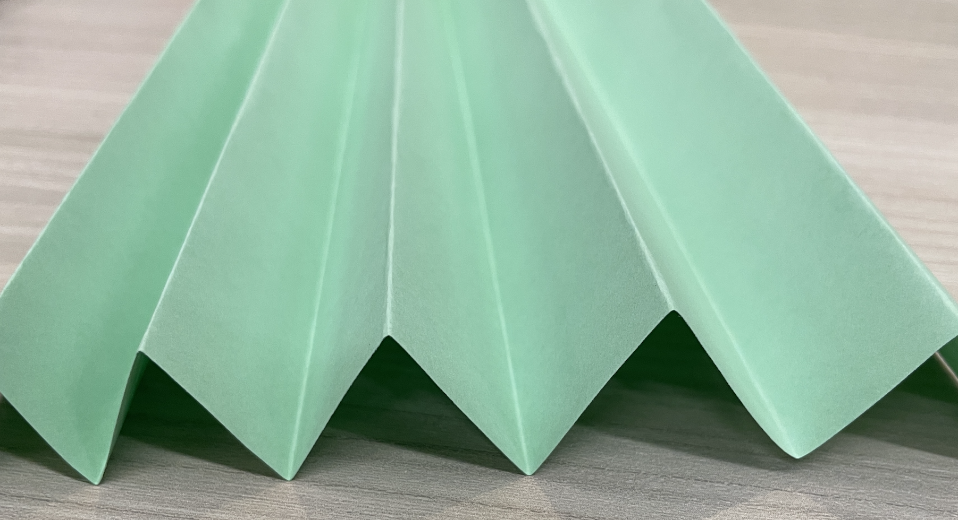
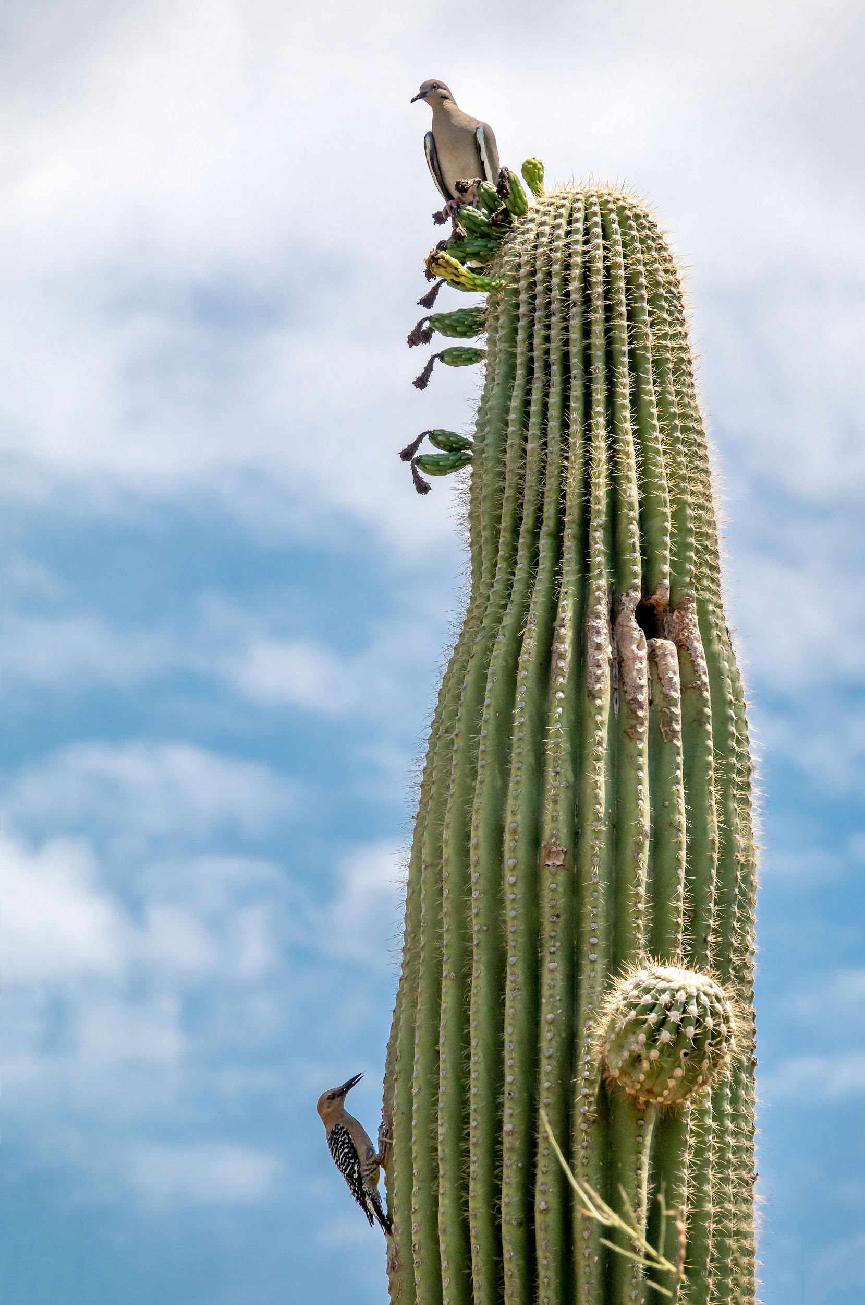
Swelling and Shrinking!
Explore-Part 2
Now that we know all about how a saguaro’s skin helps keep it from drying out, let’s talk about how they hold all that water, anyways!
Today we are going to fold some paper to look like the skin of a saguaro.
Can we make our paper saguaros thicker and thinner? How?
Photograph by Jay Pierstorff
Notes:
Guide students in folding construction paper accordion style. Have them then touch the ends of the paper to make a cylindrical shape. Have students experiment with making that shape thicker and thinner. Why do they think this can happen?

Slide 9
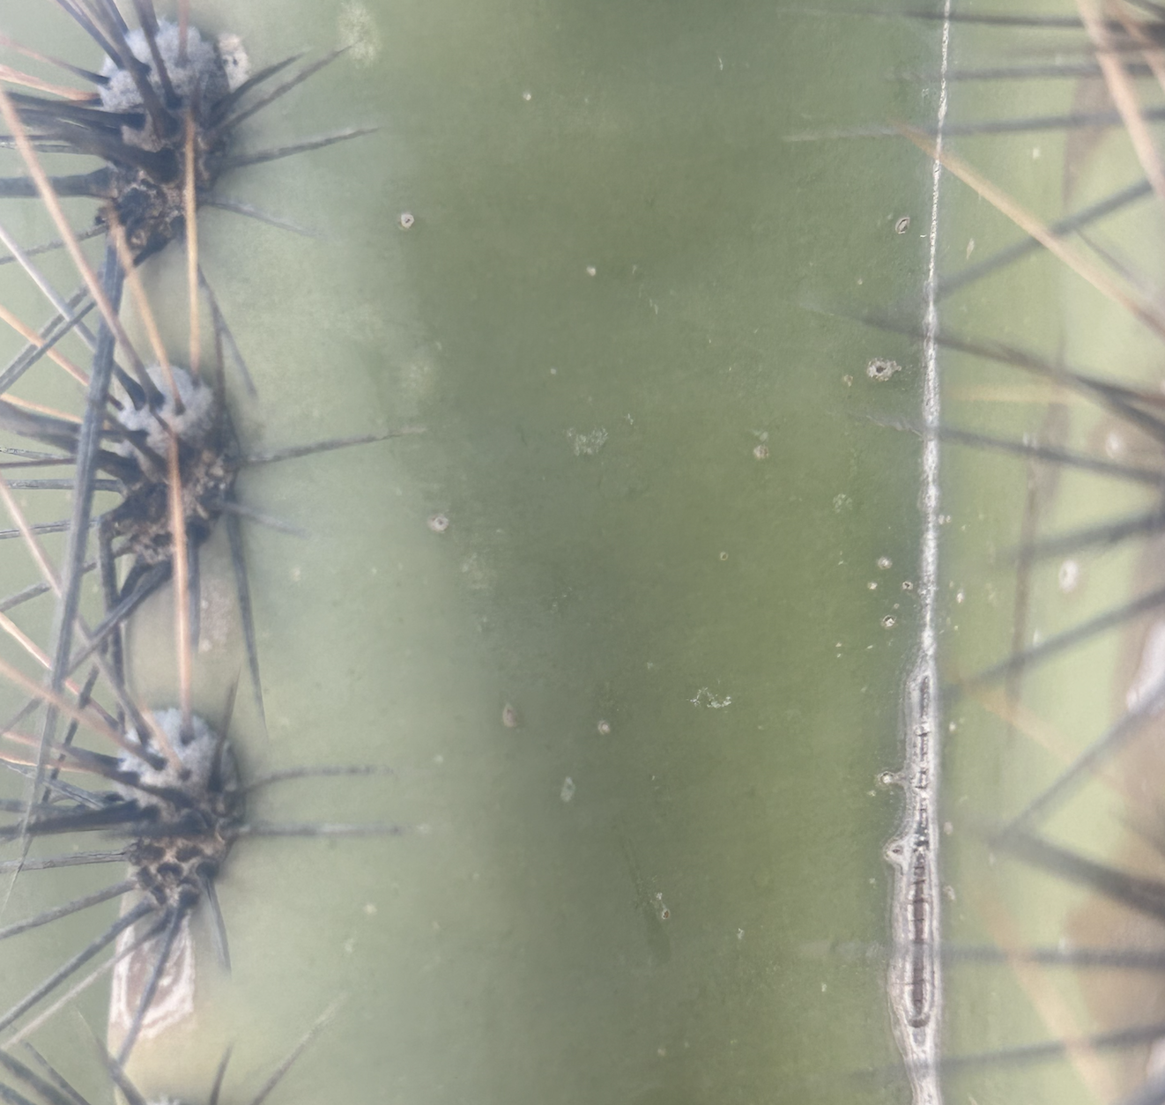
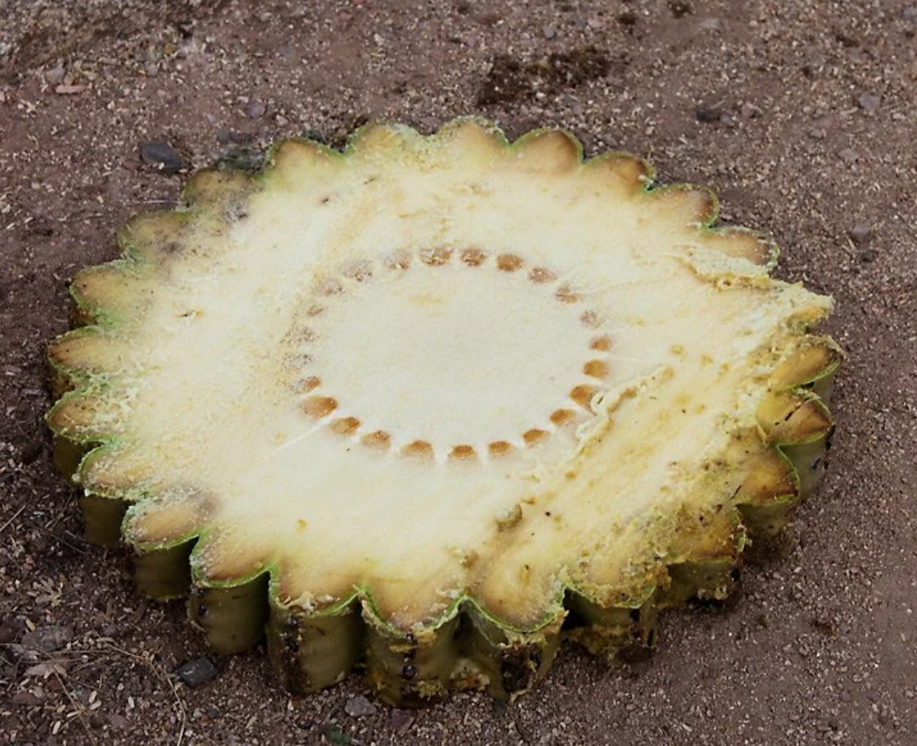
Saguaros have lots of special parts that help them survive the desert! Each part has a special function!
Explain
Saguaros have waxy skin that helps them not to lose water. Their skin takes in sunlight to make plant food!
Just like with our papers we folded, the pleats on the cactus’ skin help the saguaro to swell when rain falls and hold onto that water, and shrink when water is used up. The grooves direct rain water straight down to the roots, too!
waxy skin
pleats
Notes:
Put up vocabulary words when introduced throughout the next few slides. While talking about pleats, mention that the arms of the cactus as well as the stem hold water and can expand and contract.

Slide 10
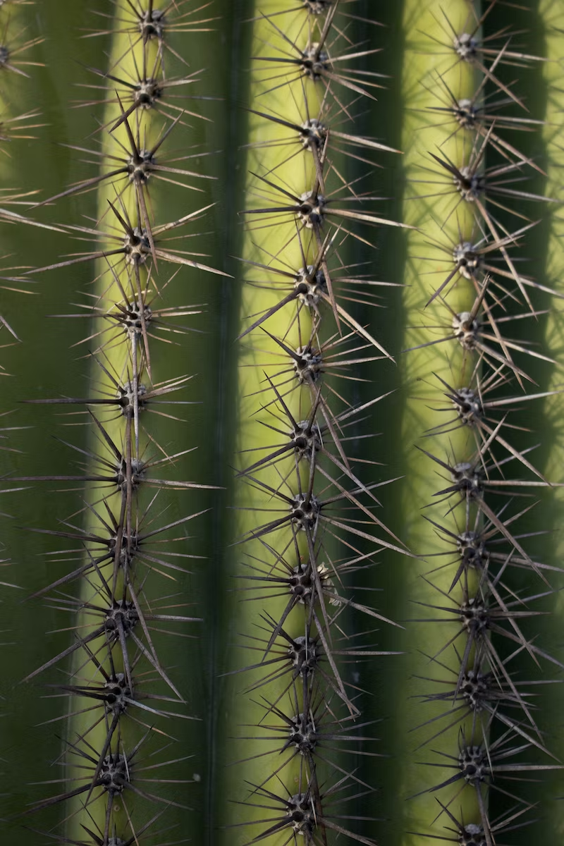
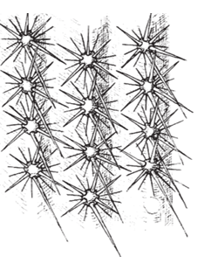
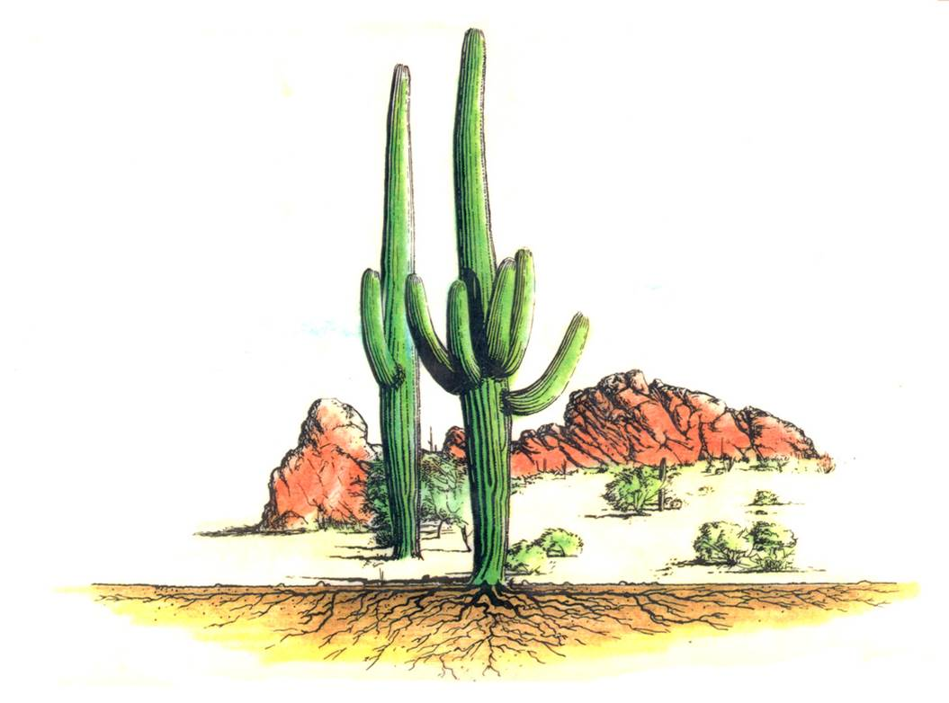
Explain
Spines help give the saguaro shade! The shade cools the saguaro down so it doesn’t lose as much water. The spines also keep away animals who might try to eat the skin of the plant!
Saguaro roots aren’t very deep underground, but they spread out! The roots take in water and keep the plant safely in place.
spines
roots
Notes:
Put up vocabulary words when introduced throughout the next few slides.

Slide 11
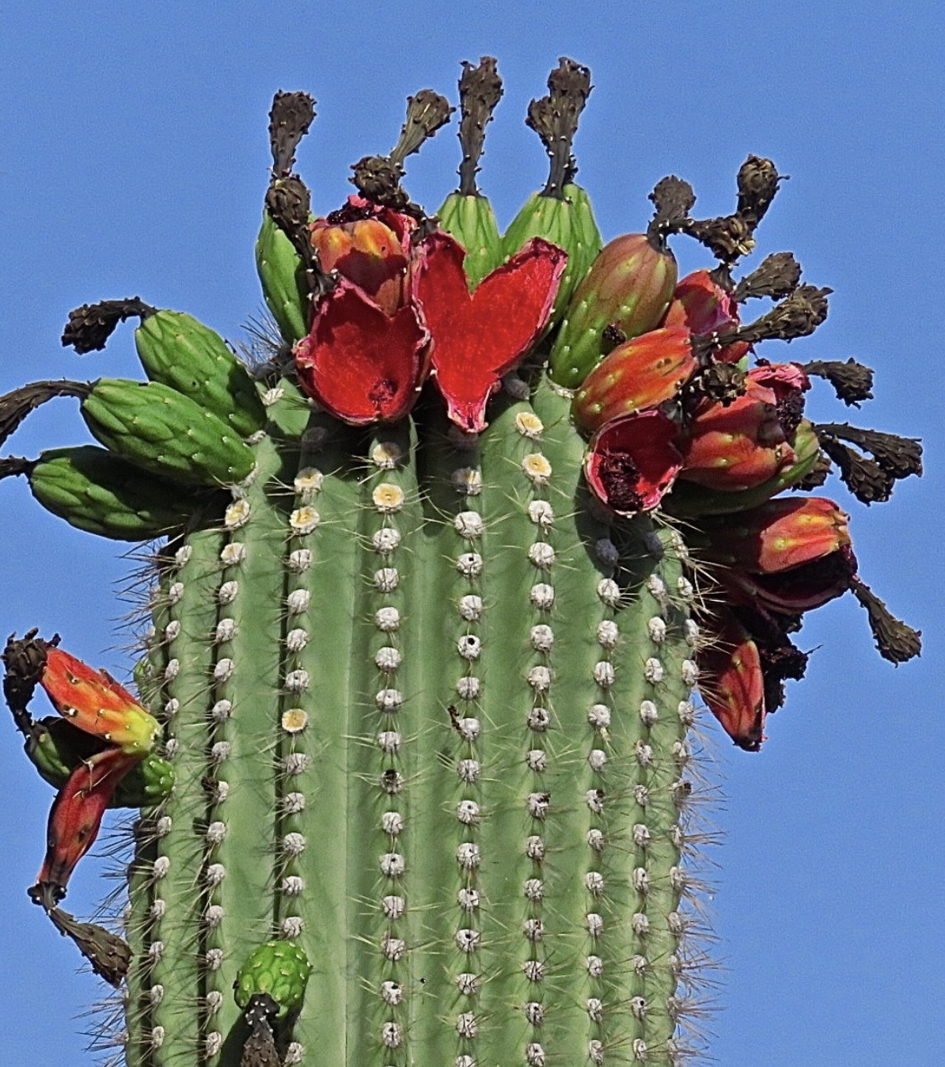
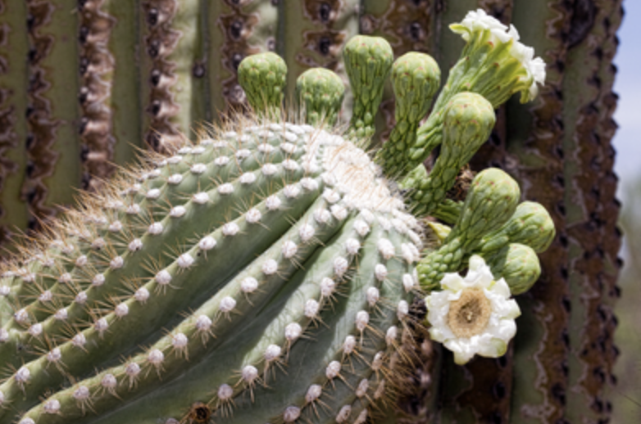
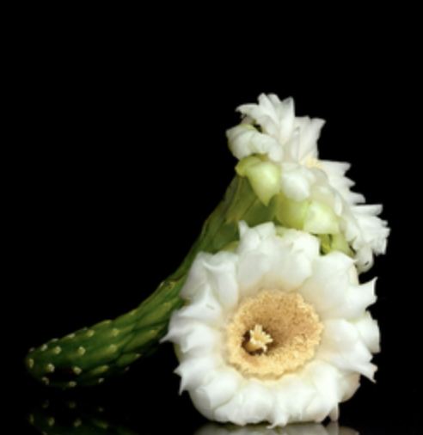
Explain
fruit
The crown of the saguaro is the top part where flowers and fruit grow. They also grow on the ends of the saguaro’s arms, too. The pollen from the flowers and the seeds from the fruit are spread, which helps new saguaros grow! The flowers and fruit also provide food for animals and humans…which we’ll learn more about later!
crown
flower bud
end of a saguaro arm
flower bloom
Notes:
Put up vocabulary words when introduced throughout the next few slides.

Slide 12
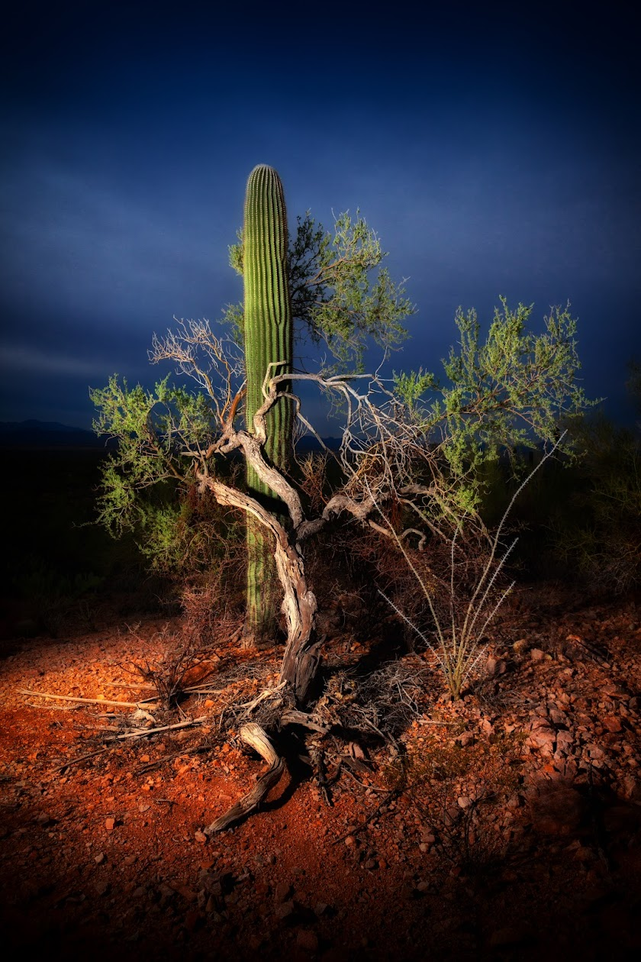
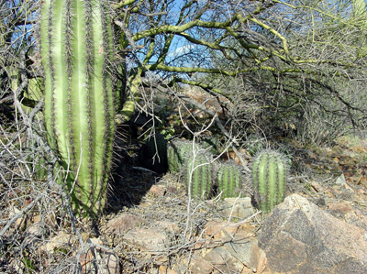
Saguaros also need help from the desert to survive!
Explain
When saguaros are little, they can easily be eaten by animals or die from the hot sun. Nurse trees, like Palo Verde Trees, help keep the saguaro shaded and cool and protected from animals that might eat them.
Notes:
Put up vocabulary words when introduced throughout the next few slides.

Slide 13
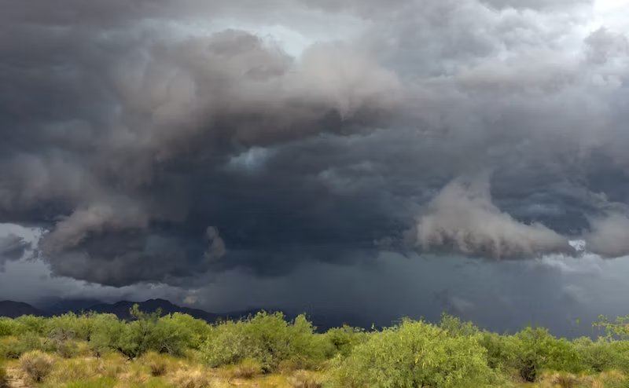
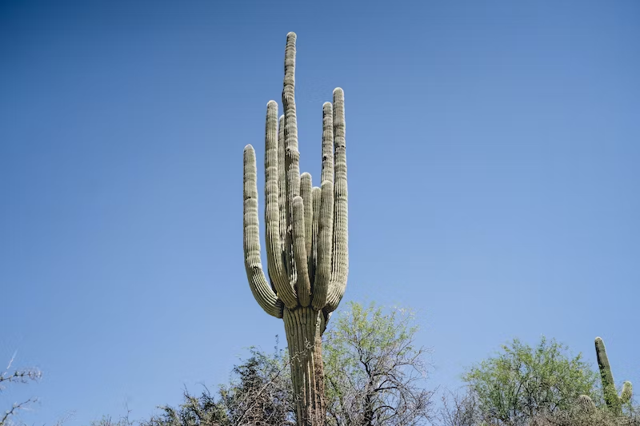
Explain
Saguaros soak up water whenever there’s desert rain. They also make food as they take in sunshine. The stem and arms of the saguaro are great for taking in sunlight and storing water!
arms
stem
nurse tree
Notes:
Put up vocabulary words when introduced throughout the next few slides.

Slide 14
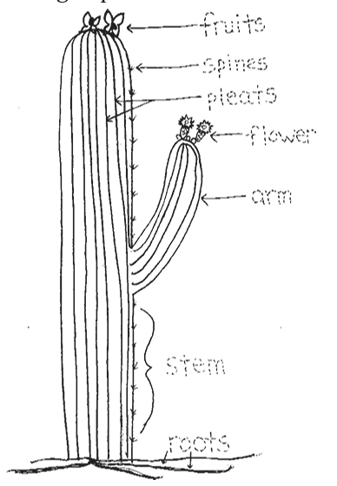
Explain
Let’s review!
Look at this picture. Tell your neighbors: how does each part of the saguaro help it survive?
Be ready to share your thoughts!
Notes:
Review with students the parts of a saguaro they just learned! You might have them draw a saguaro, or tell you how to draw one, using what they’ve learned. Focus on having students use correct names for each part of the saguaro and having them explain why each part is important.

Slide 15
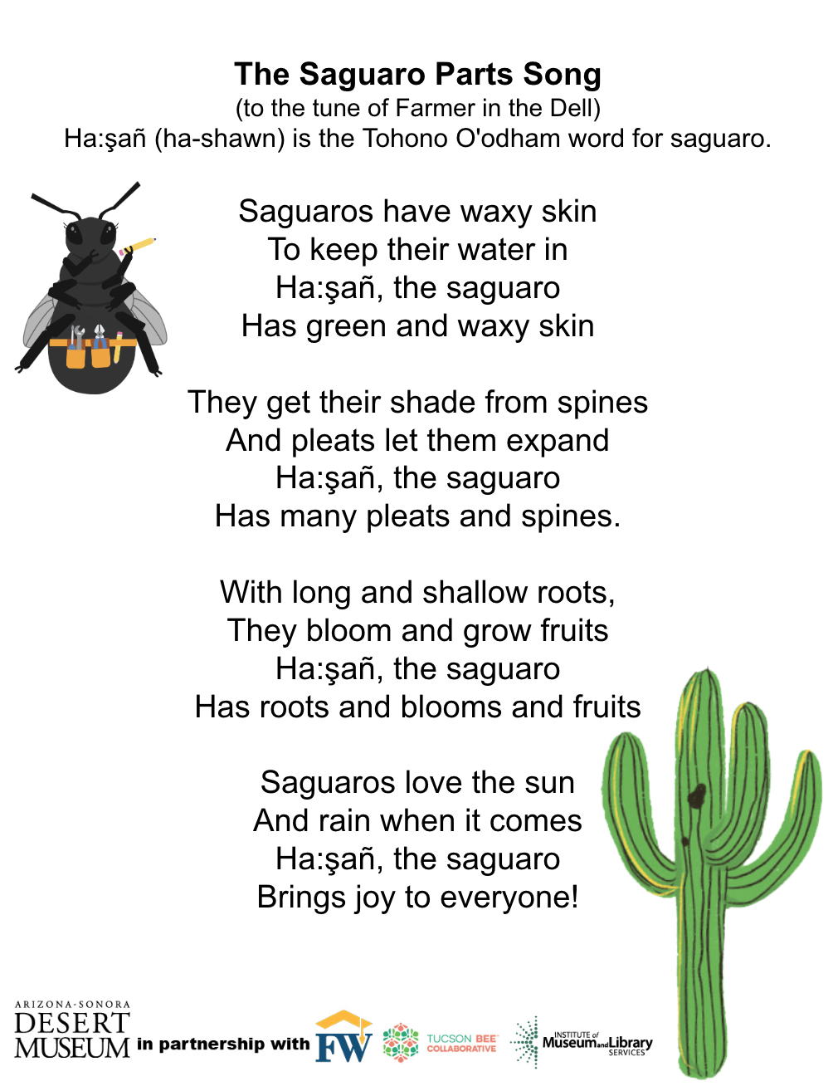
Explain/Elaborate
Sing a Song of Saguaros
Now that we’ve learned all about the parts of saguaros that help them survive, let's sing a song to help us remember all their important parts!
Notes:
Sing this song with students to practice naming the parts of a saguaro correctly!

Slide 16
Can you make a cactus?
Elaborate-Part 1
We learned a lot about the important parts of a saguaro that help it survive in the desert! Today you will get to make a model of a saguaro. What parts of the plant structure do you think you should include?
Let’s brainstorm and write some of those parts down!
Notes:
Explain to students that today they will make a model of a saguaro that should include the plant’s important parts they learned about. Use the picture on this slide to review these parts and their functions.

Slide 17
Can you make a cactus?
Elaborate-Part 1
Now it’s your turn to be like Beatrice the Bee and build a model! Make a saguaro using playdoh, toothpicks, and pipe cleaners.
Don’t forget to include all those important saguaro parts we learned about! What supplies would you use for each part?
Let’s build!
Notes:
Give students time to create and share their models. Remind students to include different parts (try to create pleats, add toothpicks for spines, etc). You might have students share their models with a peer and then go back and adjust their own models to make them better!

Slide 18
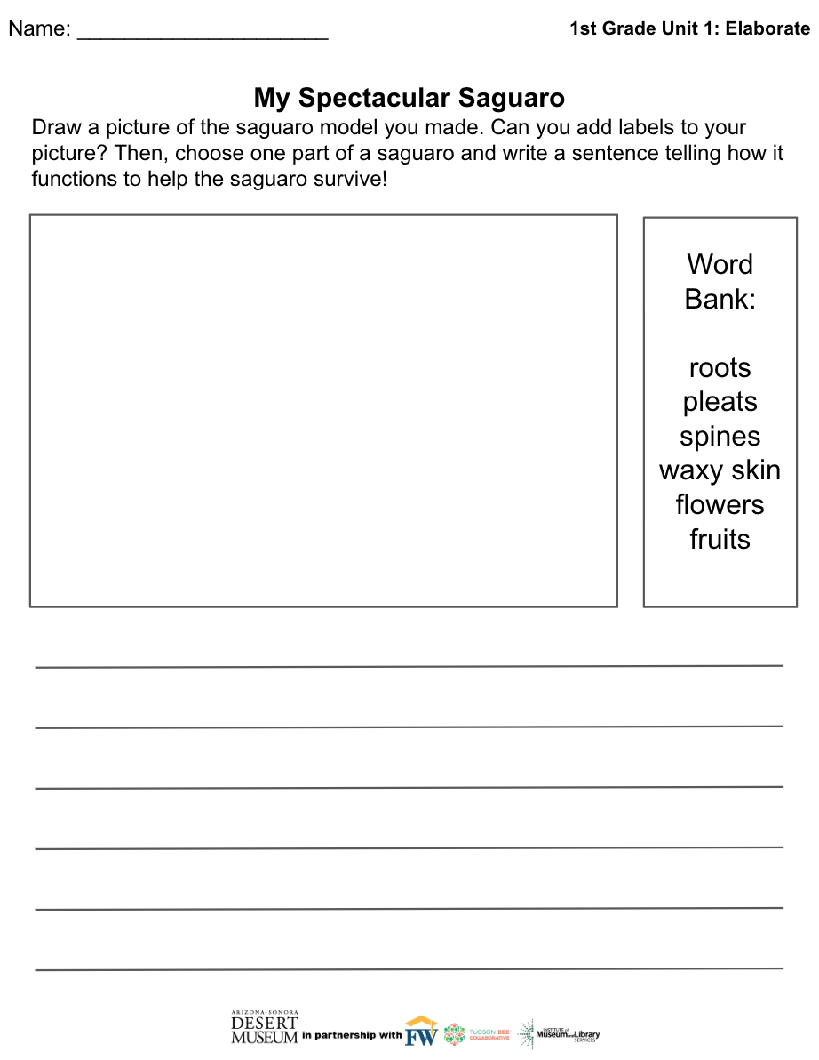
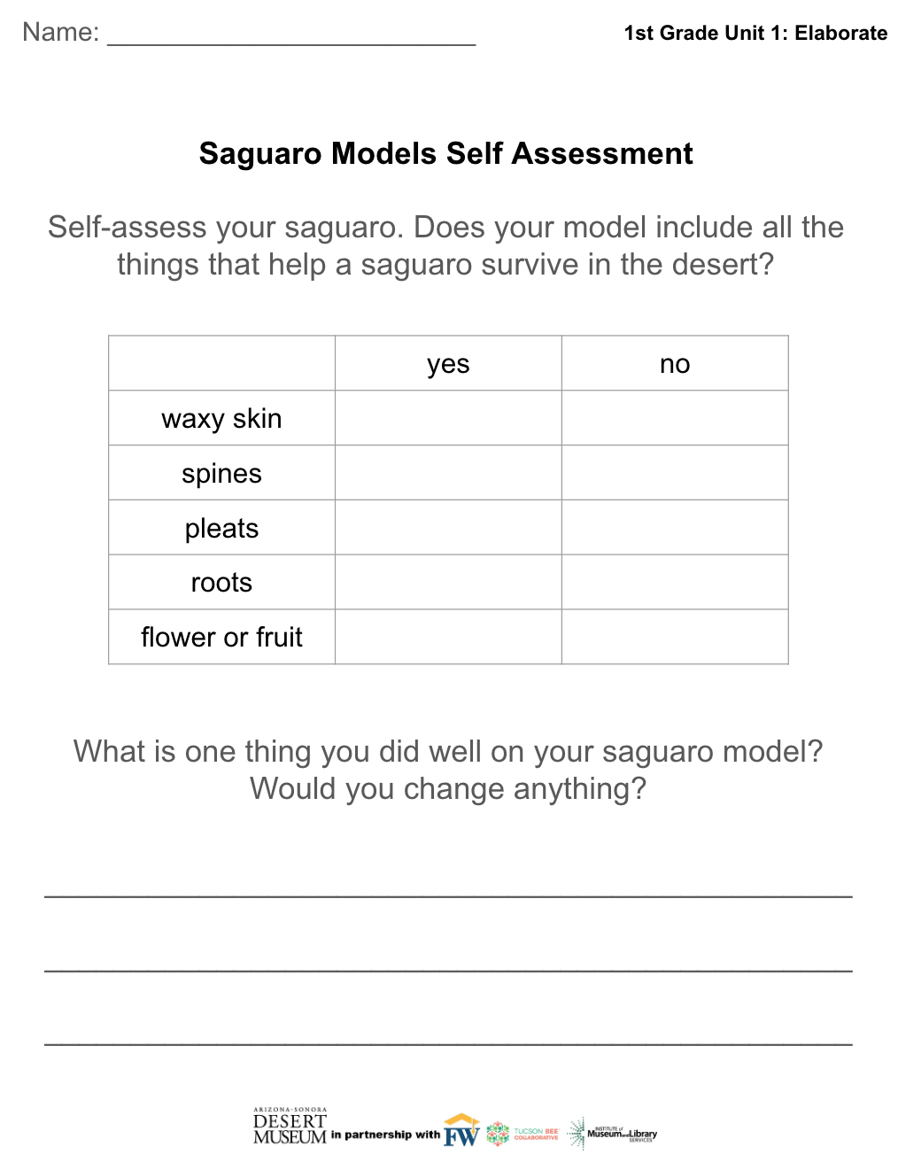
Write about your model!
Elaborate-Part 2
Now, draw a picture of the model you made. Write a sentence telling about one of the saguaro’s special parts and how it helps it survive in the desert. Your teacher may also have you self-assess your model!
Notes:
Students now draw a picture of their model and write a sentence explaining how one structure (pleats, spines, roots, etc.) helps the saguaro survive in the desert.

Slide 19

Evaluate
What a saguaro needs…
You have learned a lot about what helps a saguaro survive in the desert!
-It has special parts that serve different functions: collecting food and water, etc.
-It also needs certain things from the environment around it!
Today your job is to draw a thriving saguaro! What is on its body? What things surround it? What weather is good for it?
Notes:
Now students draw a saguaro in detail and in conditions where it would thrive (sunny or some rain, a nurse tree nearby, roots underground, etc.)

Slide 20
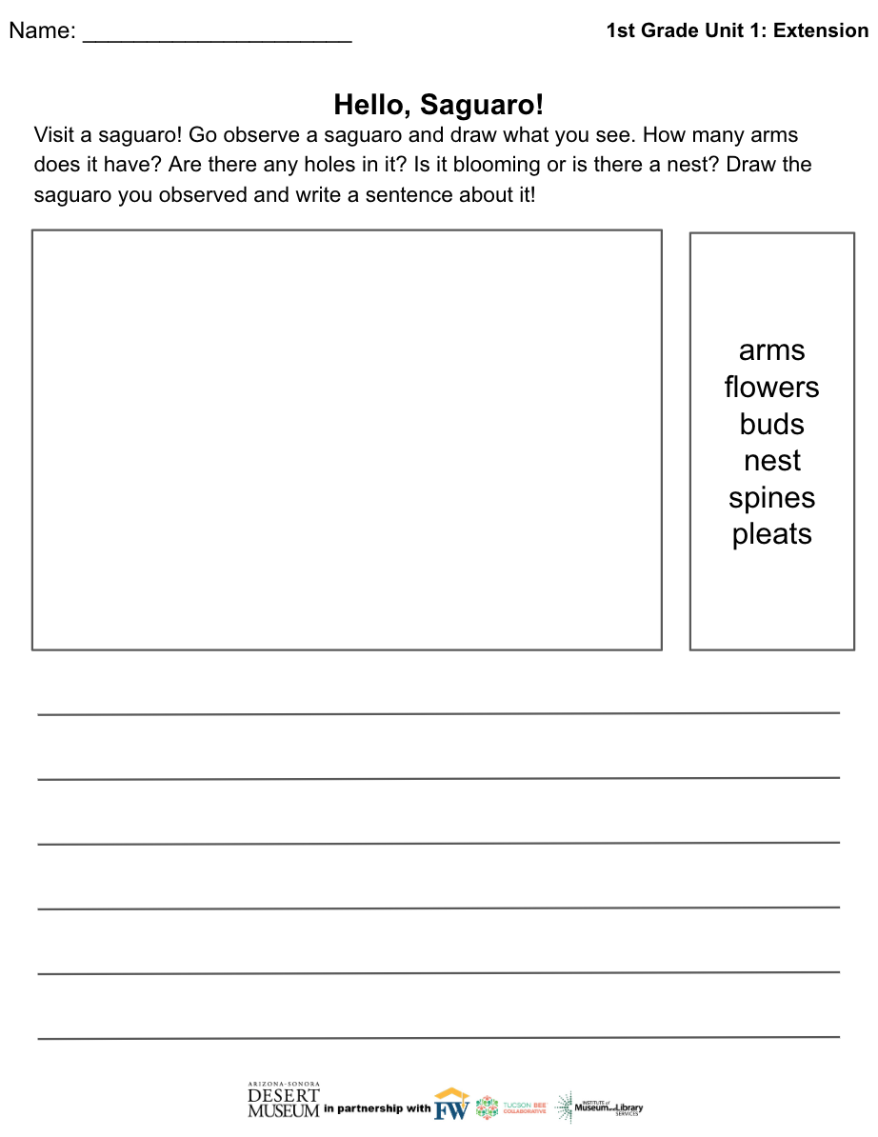
Extension
Hello, Saguaro!
Go visit a saguaro! Observe it! What do you notice? How many arms does it have? Is it currently blooming? Are there any nests on it? Draw and write about what you see!

Slide 21
Extension
How Big Is A Saguaro?
Measure a saguaro! If you have a saguaro nearby, use a string to measure its circumference. After a rainy day, measure the same saguaro again with a different piece of string. Then compare the two! Why did your saguaro measure larger after the rain?

